Slide 1

GOVERNMENT COLLEGE OF ENGINEERING,BARGUR
(An Autonomous Institution Affiliated to Anna University, Chennai)
DEPARTMENT OF ELECTRONICS AND COMMUNICATION
ENGINEERING
A IoT-DRIVEN HOSTEL MANAGEMENT AND STUDENT PROTECTION ECOSYSTEM
TEAM MEMBERS:
GOPIKA C
RAJALAKSHMI R
SANDHIYA S
THIRISHA M
Under the guidance of,
Dr.V.Thirunavukkarasu, M.E.,Ph.D.,
Principal.

Slide 2
ABSTRACT
  The IoT-Driven Hostel Management and Student Protection Ecosystem aims to enhance hostel management, student safety, and operational efficiency through Internet of Things (IoT) technology. The proposed system comprises four modules: Automated Hostel Attendance System, Automated Absentee Notification System, Parent Notification System for Student Entry and Exit, and Smart Hostel Automation and Resource Management System. By integrating an ESP32 microcontroller, sensors, Wi-Fi connectivity, and automated notification services, the system streamlines attendance monitoring, facilitates timely communication with wardens and parents, enhances student safety, and promotes efficient resource utilization. This integrated solution minimizes manual intervention and provides a reliable and secure hostel management environment.

Slide 3
EXISTING SYSTEM
The existing hostel management system primarily relies on manual procedures for attendance tracking, absentee monitoring, parent communication, and resource management. Student attendance is maintained through registers or conventional methods, while absentee information is communicated to wardens and parents manually. The lack of real-time notifications regarding students’ entry and exit limits parents’ ability to monitor their wards’ safety. Furthermore, hostel resources such as lighting, fans, and water tanks are generally managed through manual monitoring, which can lead to inefficient resource utilization and increased administrative workload. These limitations highlight the need for an integrated, automated, and reliable hostel management system that enhances student safety, communication, and operational efficiency.

Slide 4
PROPOSED SYSTEM
The proposed IoT-Driven Hostel Management and Student Protection Ecosystem integrates IoT technology to automate hostel attendance, absentee monitoring, parent notifications, and resource management. The system records student attendance digitally and automatically sends absentee reports to the warden and notifications to parents. It also provides real-time alerts to parents regarding their daughter’s entry into and exit from the hostel, enhancing student safety and transparency. Additionally, smart automation enables efficient monitoring of water levels and control of electrical appliances, reducing resource wastage. By integrating an ESP32 microcontroller, sensors, Wi-Fi connectivity, and automated notification services, the proposed system minimizes manual intervention, improves operational efficiency, and provides a secure and intelligent hostel management environment.

Slide 5
THE MODULES IN OUR PROJECT ARE:
ATTENDANCE REGISTER WITH PARENT AND WARDEN NOTIFICTION
NOTIFICATION OF ENTER AND EXIT OF HOSTEL TO PARENT
HOSTEL ROOM MANAGEMENT
HOSTEL MATE APP (COMPLAINT APP)
SNAKE DETECTION ROVER USING ESP32 -CAM

Slide 6
1.ATTENDANCE REGISTER
* Implements fingerprint-based attendance monitoring to record student entry into the hostel between 3:00 PM and 6:00 PM.
* Automatically stores attendance details, including student name, date, and entry time, in Google Sheets.
* Identifies absent students based on attendance records after 6:00 PM.
* Automatically sends an absentee report to the warden via email between 6:00 PM and 7:00 PM.
* Sends automated absence notifications to parents, informing them that their ward has not recorded attendance for the day.
* Integrates ESP32, a fingerprint sensor, Google Sheets, and Google Apps Script to ensure reliable attendance tracking and timely communication.

Slide 7
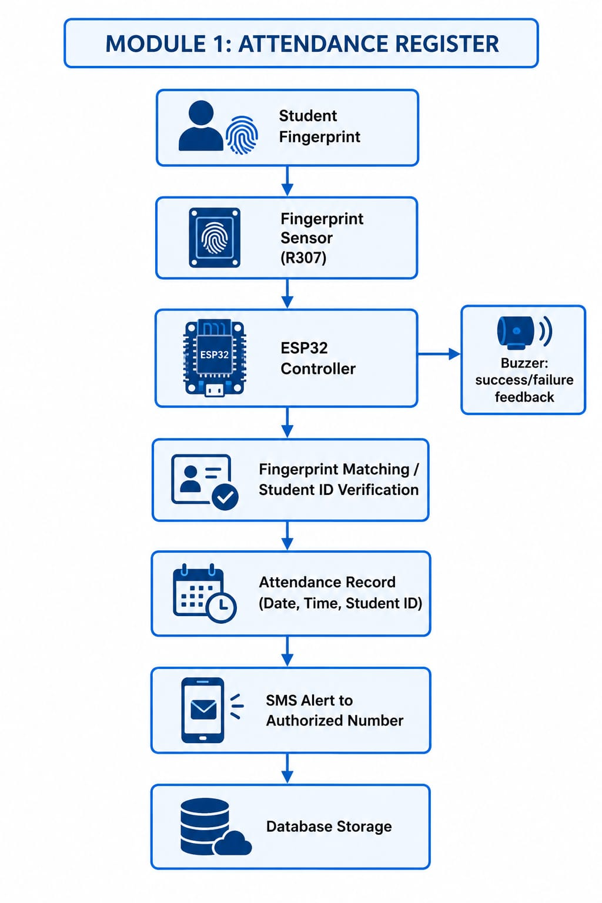

Slide 8
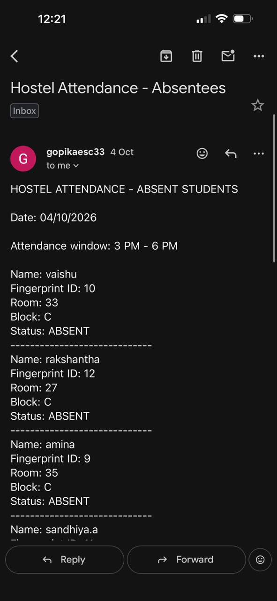
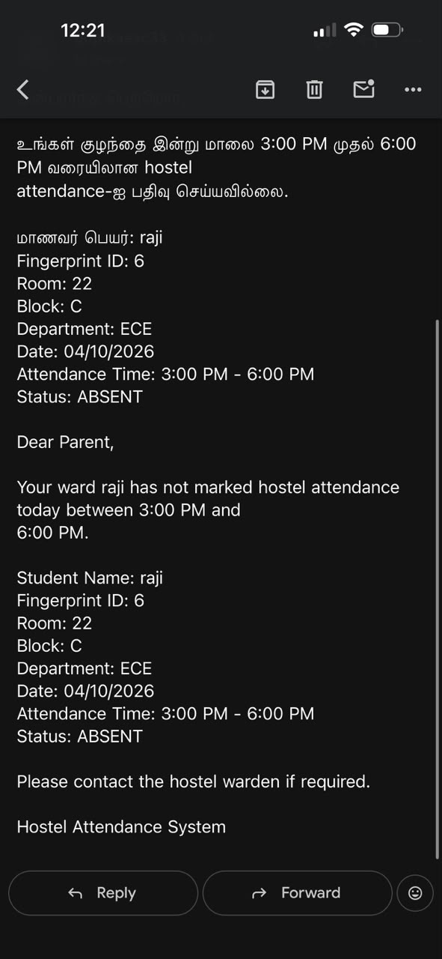
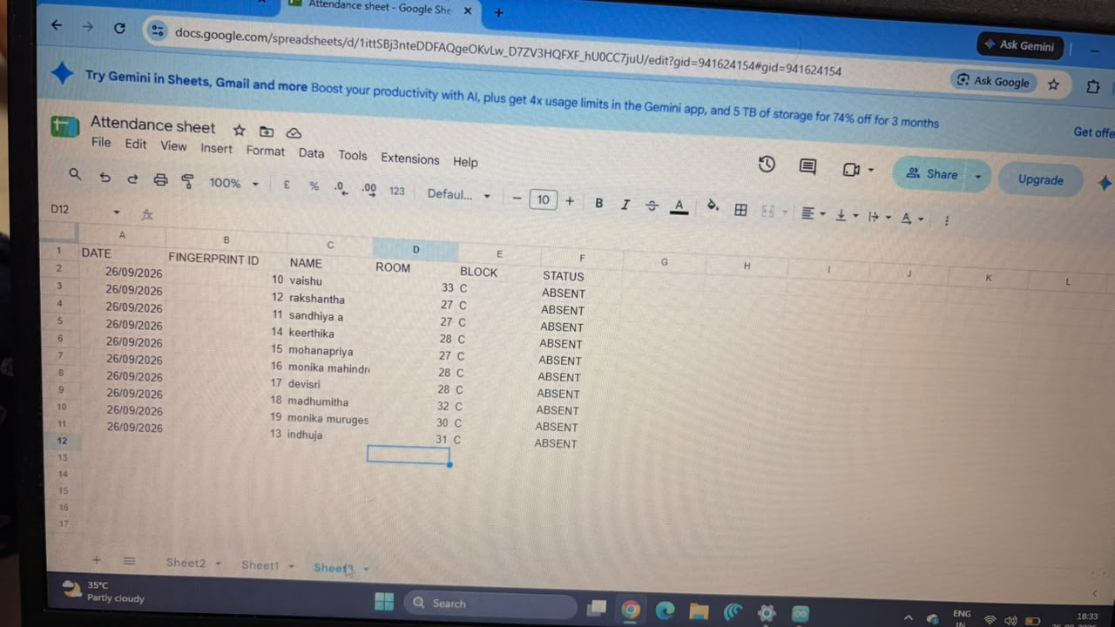

Slide 9
2.PARENT NOTIFICATION
* Sends automated notifications to parents through SMS.Whenever their daughter enters or leaves the hostel.
* Includes the student’s name, entry or exit status, date, and time in each notification.
* Provides real-time updates on student movements, enabling parents to stay informed.
* Enhances student safety through timely communication and continuous movement monitoring.
* Integrates IoT technology and automated notification services to ensure reliable communication between the hostel and parents.

Slide 10
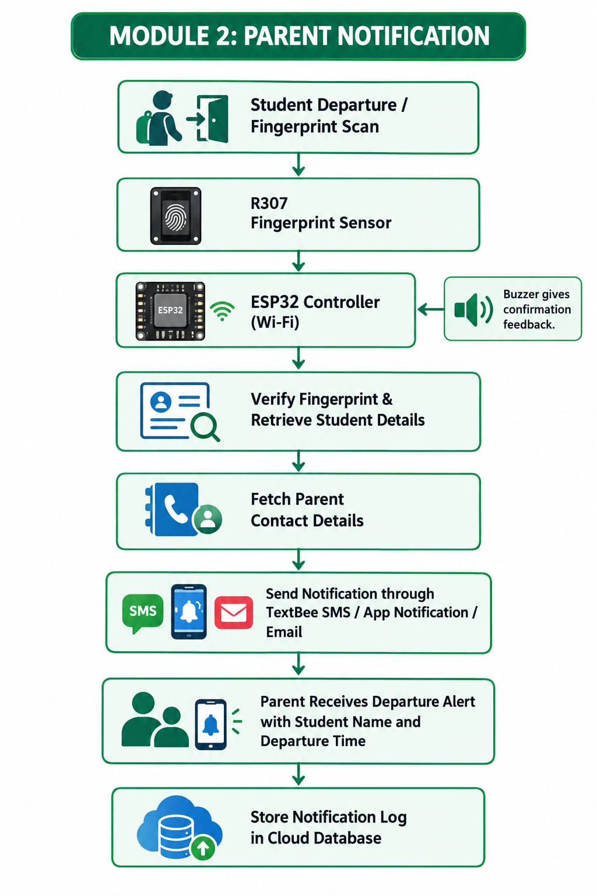

Slide 11
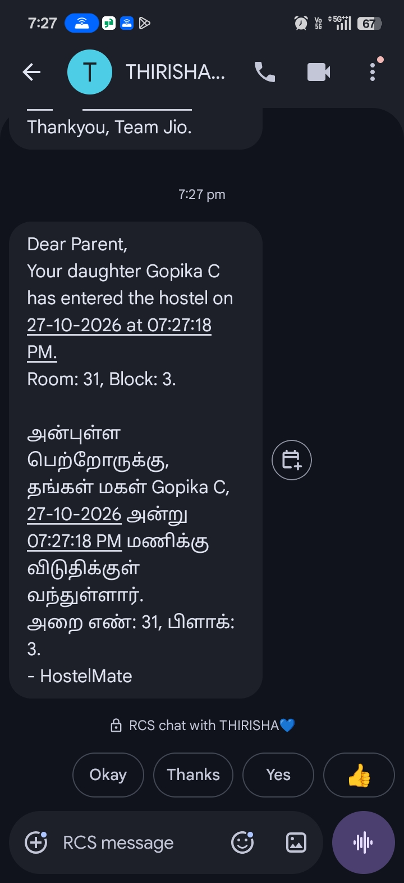
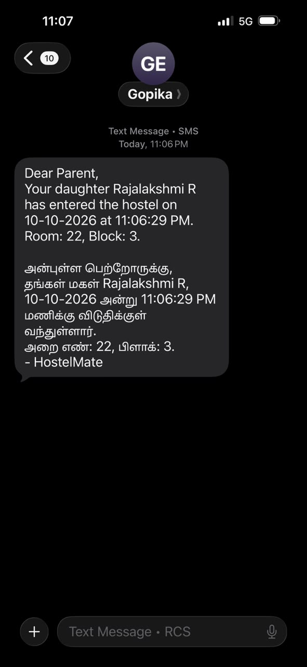

Slide 12
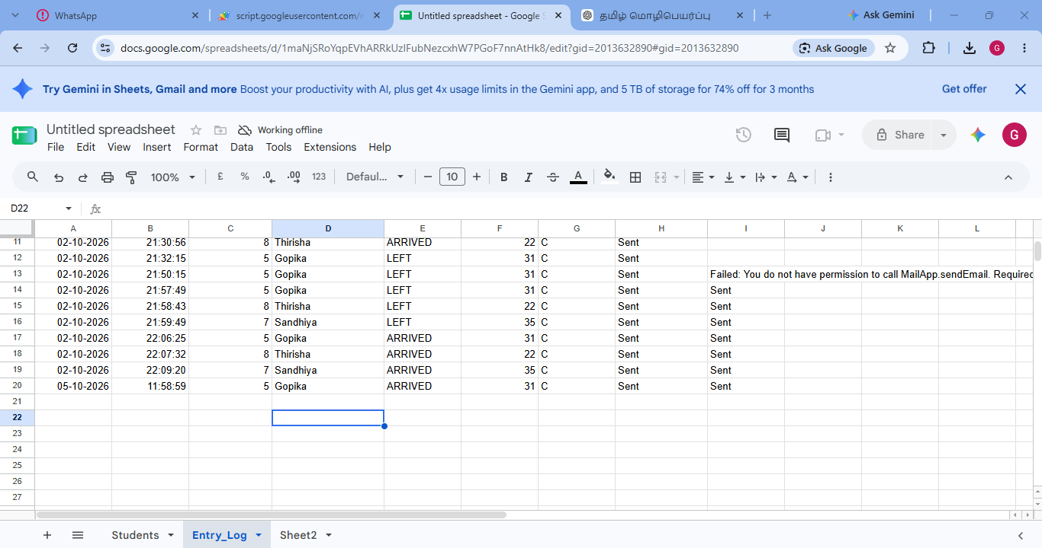

Slide 13
3.HOSTEL ROOM MANAGEMENT
* Uses a Real-Time Clock (RTC) to monitor predefined time intervals: 9:00 AM–12:00 PM and 2:00 PM–4:00 PM.
* Detects room occupancy using a Passive Infrared (PIR) sensor during the specified periods.
* Processes occupancy data through the ESP32 microcontroller and transmits it via the Blynk IoT platform.
* Sends room occupancy status notifications to the warden through the Blynk application.
* Enables efficient room monitoring and supports improved hostel management.

Slide 14
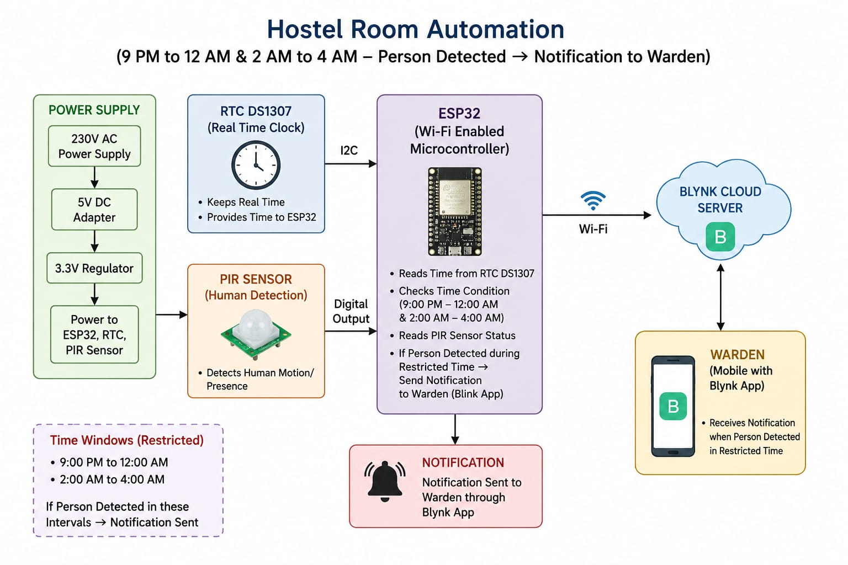
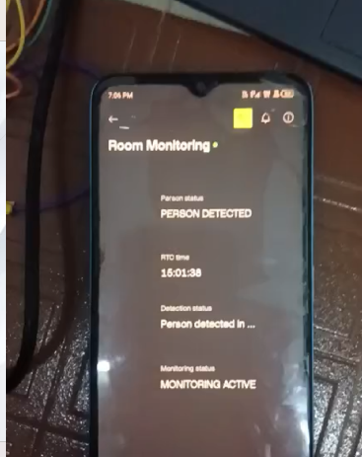

Slide 15
4.HOSTEL MATE APPLICATION
* Enables students to submit complaints regarding hostel facilities and maintenance through a mobile application.
* Allows students to search for and track complaints using complaint IDs or relevant keywords.
* Displays complaint status as Submitted, Received, In Progress, or Resolved.
* Provides an administrator/warden dashboard to monitor, manage, and resolve complaints efficiently.
* Allows students to access their profile details, including hostel block and room number.
* Improves communication between students and hostel management while ensuring efficient complaint handling and maintenance management.

Slide 16
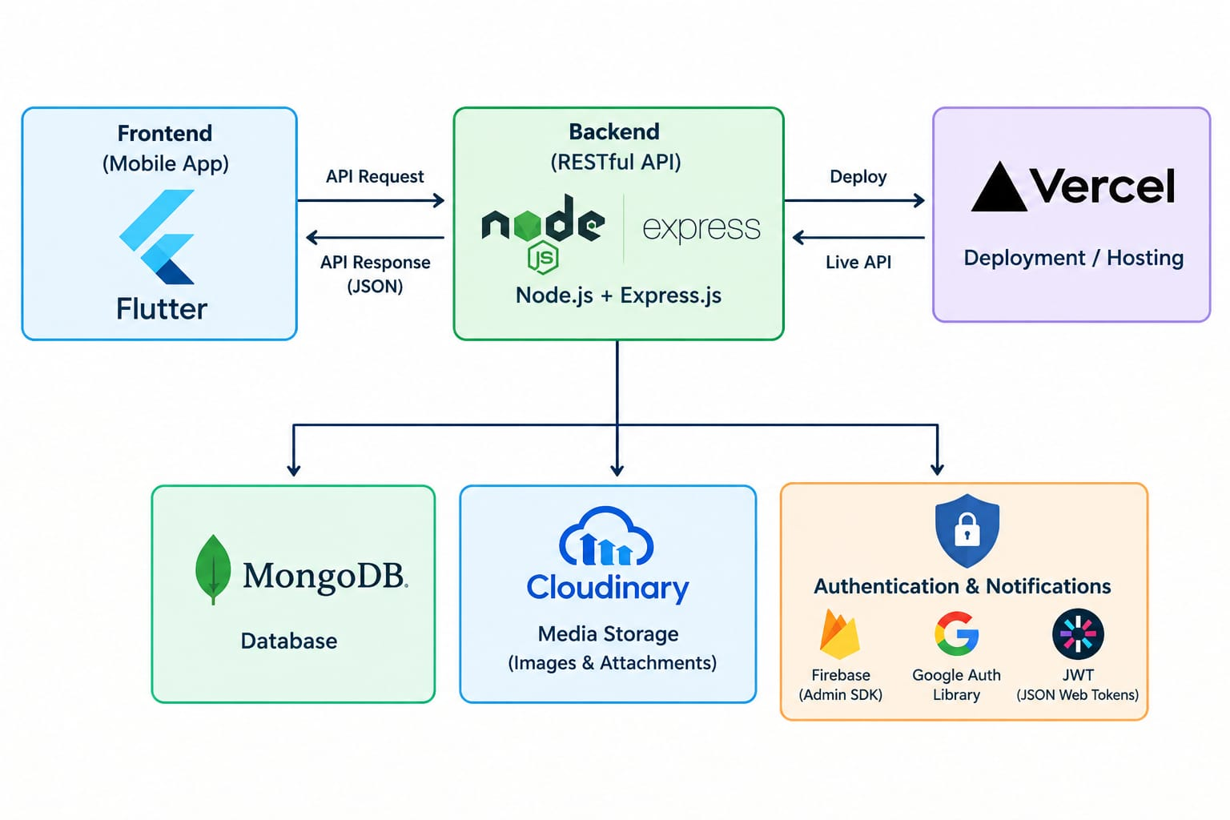

Slide 17
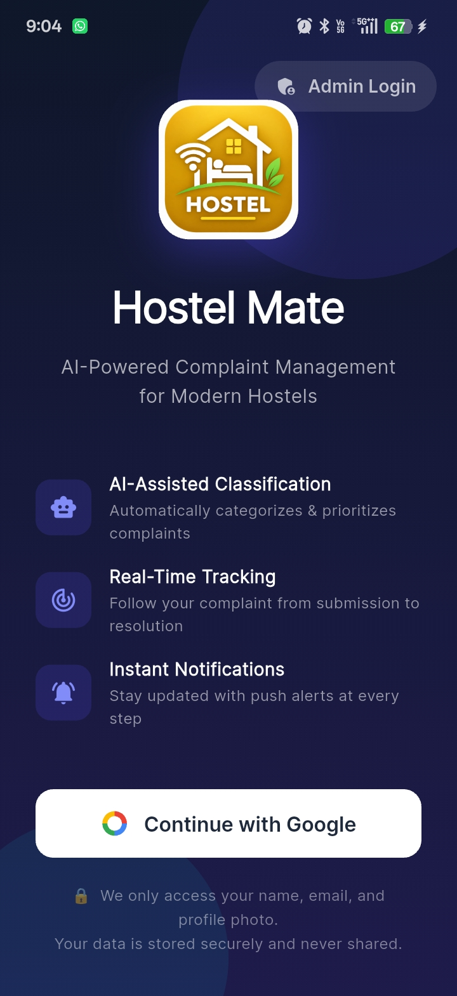
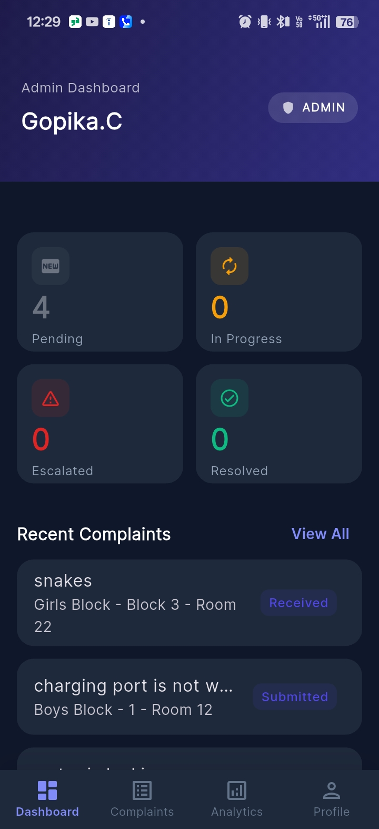
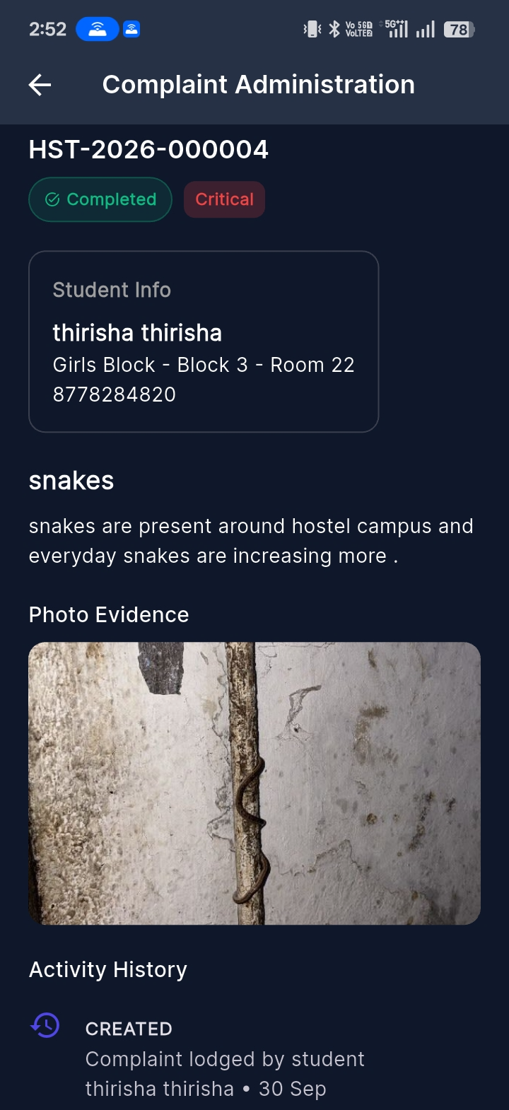

Slide 18
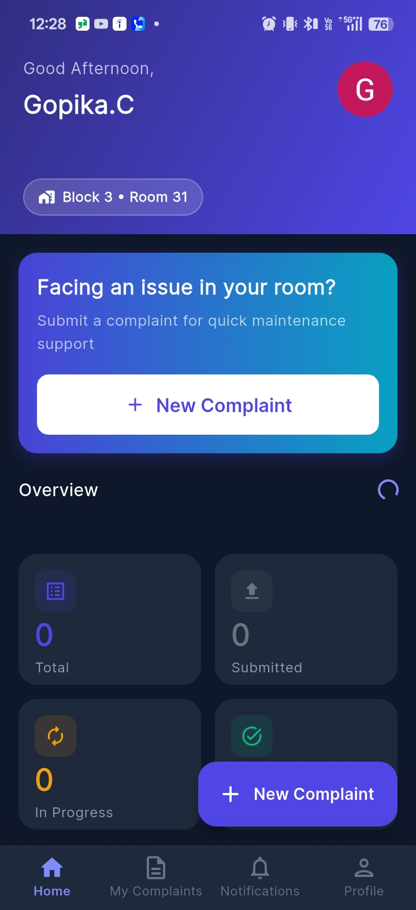
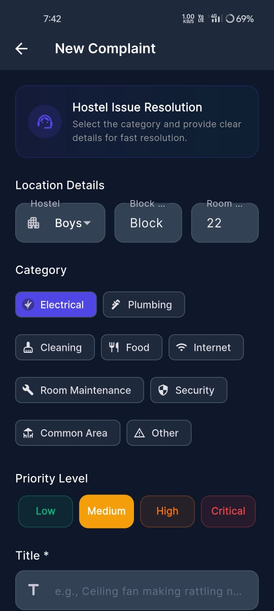
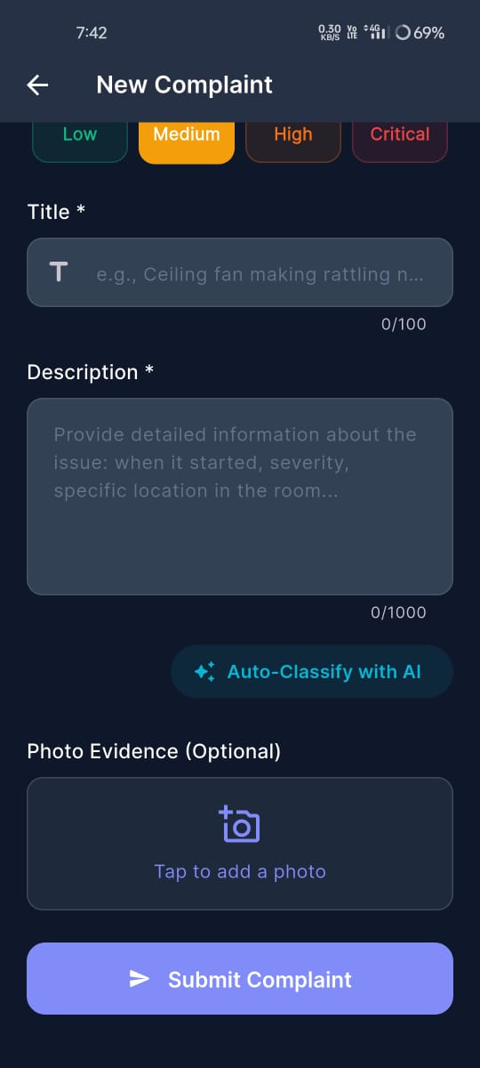

Slide 19
5.SNAKE DETECTION ROBOT
* Uses an ESP32-CAM to detect snakes and transmit signals wirelessly.
* Integrates ultrasonic sensors, a motor driver, and geared motors for movement and obstacle detection.
* Sends detection alerts to a NodeMCU receiver near the hostel gate.
* Activates a buzzer and sends real-time notifications to the warden or watchman through Blynk IoT.
* Identifies the affected hostel area (Block 1, Block 2, or Block 3) to enable a timely response and improve student safety.

Slide 20
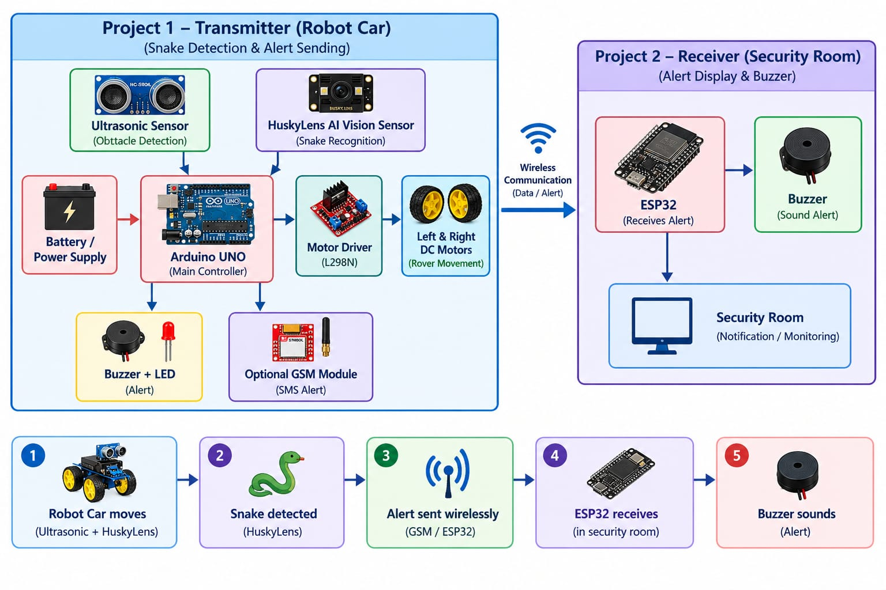

Slide 21
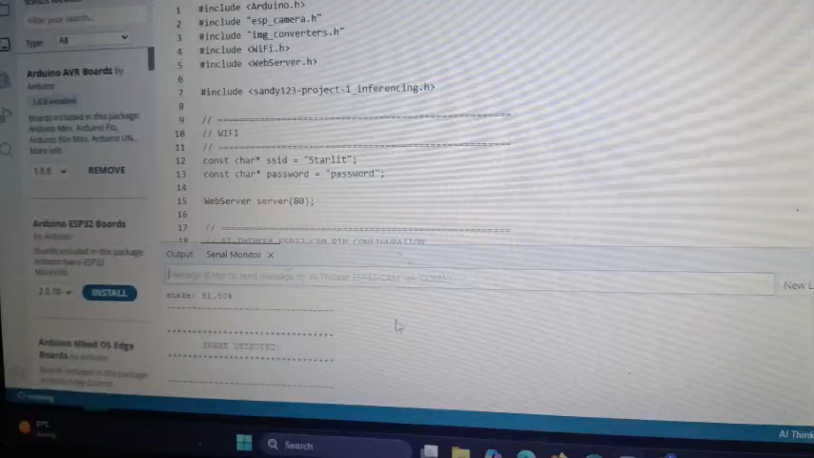
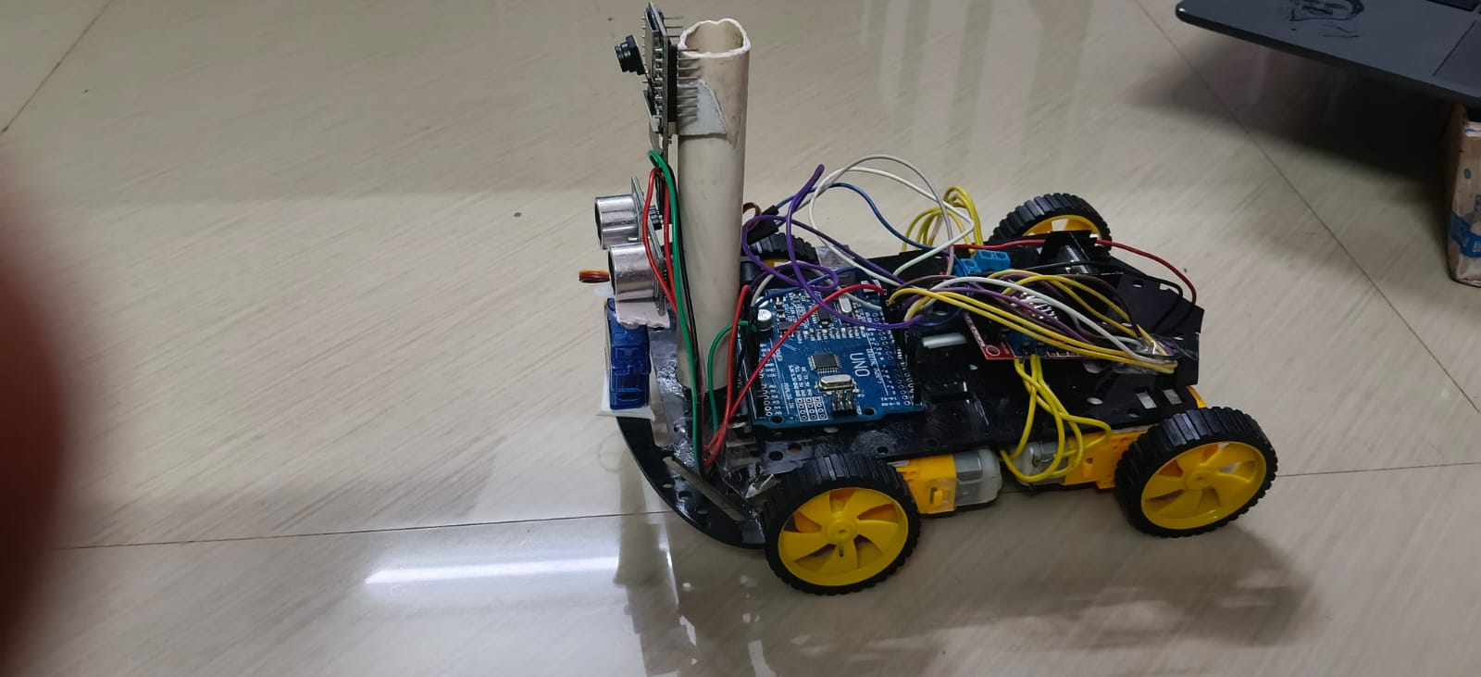
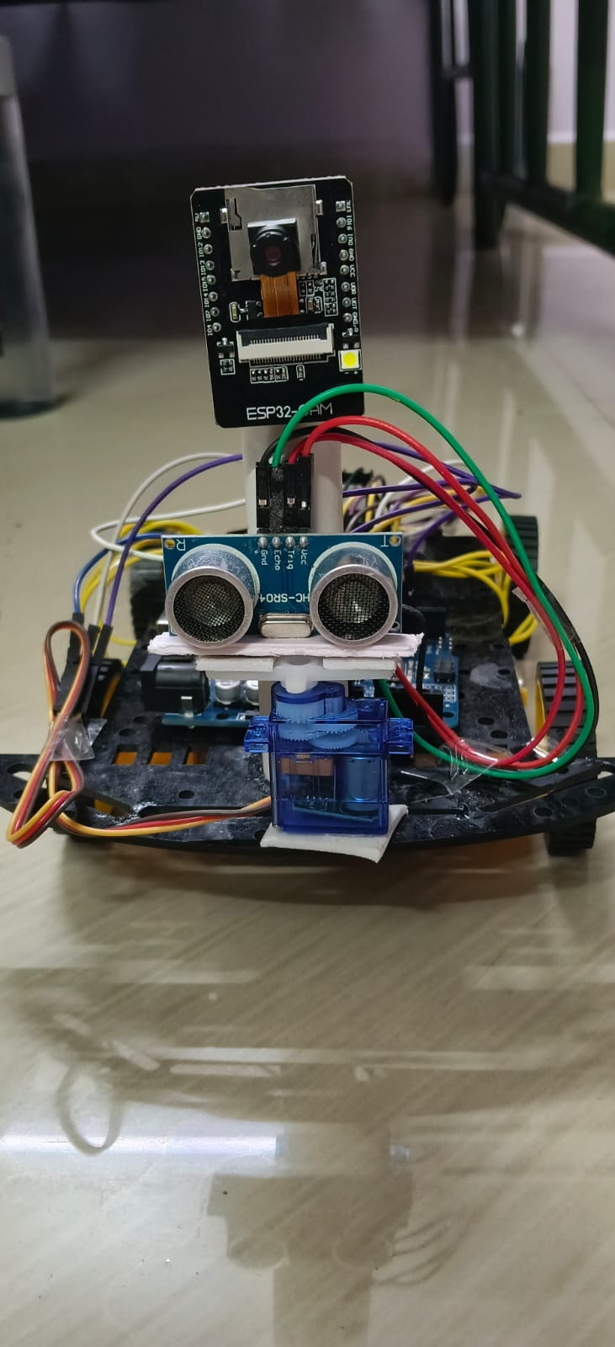

Slide 22
ADVANTAGES
* Automates student attendance tracking and absentee notifications.
* Provides real-time entry and exit notifications to parents.
* Enhances student safety through timely communication and monitoring.
* Simplifies complaint registration and tracking through the Hostel Mate application.
* Enables early snake detection and immediate alerts to hostel authorities.
* Provides an integrated, reliable, and smart hostel management solution.

Slide 23
DISADVANTAGES
* Dependence on stable Wi-Fi connectivity for real-time notifications and data synchronization.
* Power failures may interrupt system operation and monitoring.
* Fingerprint recognition may occasionally fail due to sensor or finger conditions.
* Delays in email and Telegram notifications may occur due to network or service issues.
* Snake detection accuracy may be affected by lighting conditions, camera quality, and environmental factors.
* Initial installation, maintenance, and hardware costs may be relatively high.

Slide 24
FUTURE SCOPE
* AI-Based Attendance Analytics: Analyze attendance patterns to identify repeated absences and generate monthly attendance reports for hostel administrators.
Smart Energy Management: Automatically control hostel lighting and electrical appliances according to occupancy and predefined schedules to reduce electricity consumption.
Centralized Multi-Hostel Management: Extend the application to manage multiple hostels with centralized attendance records, complaint tracking, and security monitoring.

Slide 25
THANK YOU

